Slide 1
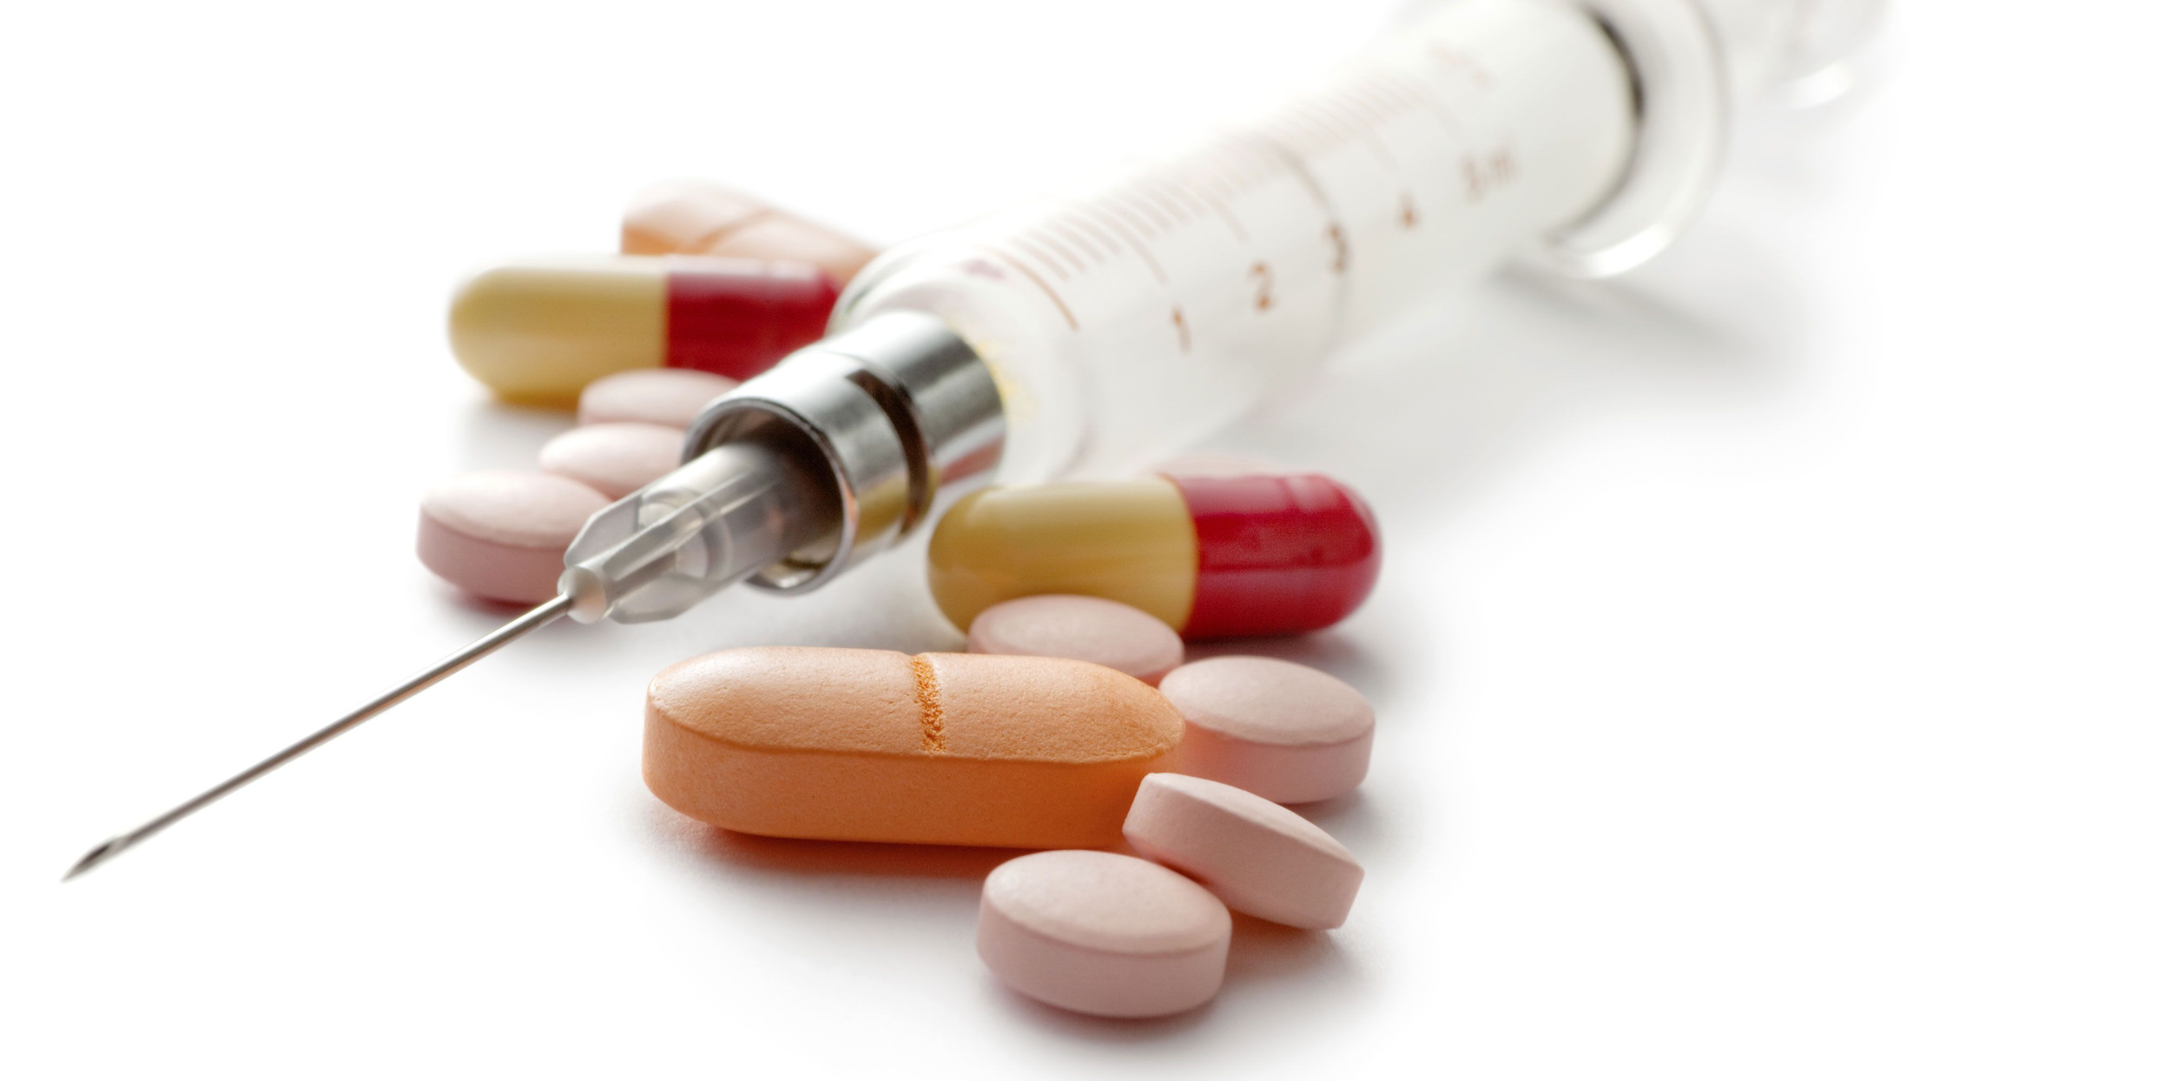
Global Market of Amoxiclav(Amoxicillin+Clavulanic Acid)
Global Techno-Commercial Report

Slide 2
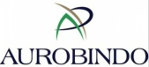
Executive Summary
Global & Indian Amoxiclav Market 2020-21 in a Nutshell
by Volume
10,000t
by Value
~ $62m
Global Amoxiclav
Market
by Volume
15.1KT
by Value
$32.4M
Growth rate
2020-21-2021-22
7%
2020-21
by Volume
10,000t
by Value
~ $62m
Indian Amoxiclav
Market
by Volume
14.2KT
by Value
$xxM
Growth rate
2020-21-2021-22
xx%
Global Amoxiclav Manufacturers Market share by Geography
Global Amoxiclav Manufacturers
by Geography
Top 5 Global Manufacturers
Aurobindo Pharma
Protech Biosystems
Pvt Ltd
Micro Labs Ltd.
Aaltop
Healthcare Pvt. Ltd,.
2020-21
2020-21
Total No. of Buyers of global Amoxiclav is **with the buying quantity of 15.1KT
The report also contains the profile of country wise buyers with their buying quantities & contact details

